Slide 1
Discrete Cosine Transform

Slide 2

Discrete cosine transform (DCT) can linearly transform data
into the frequency domain
The data can be represented by a set of coefficients.
The energy of the original data may be concentrated in only a few
low frequency components of DCT depending on the correlation in the data.
DCT express a signal (a set of numbers) in terms of a sum of
cosine functions with different frequencies
one dimensional discrete cosine transform coefficients (actually the weights)
are given by

Slide 3
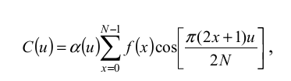


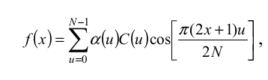
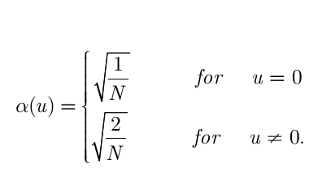


If k=0

Slide 4
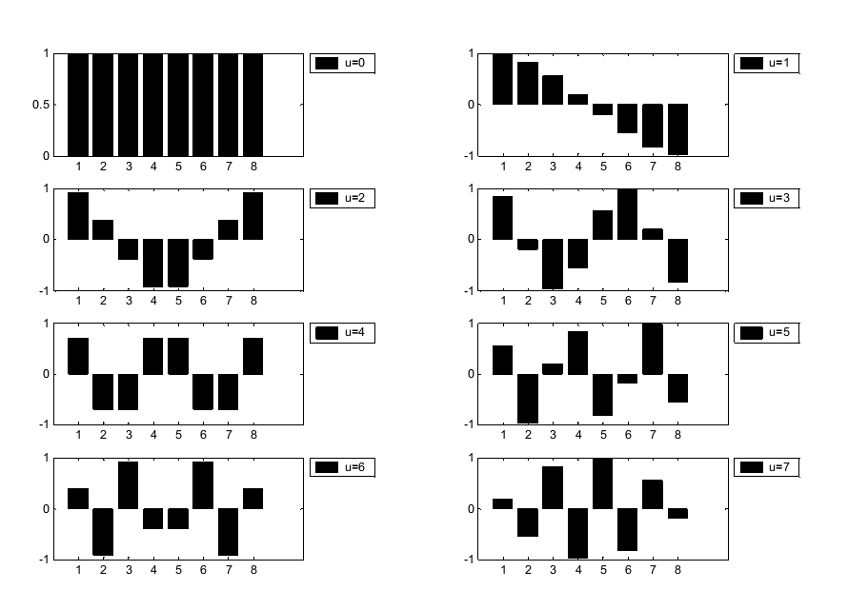
Basis functions for N=8

Slide 5

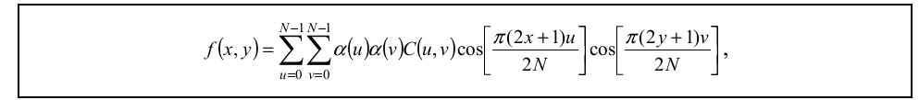
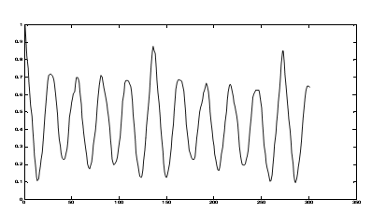
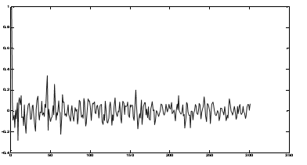
2D DCT
2D transformation can be obtained by two 1D operations
Row-→column
Autocorrelation of image before and after DCT

Slide 6

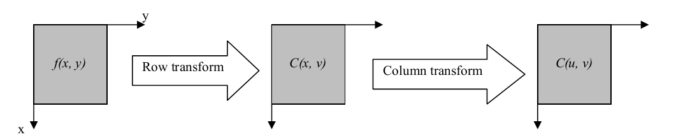
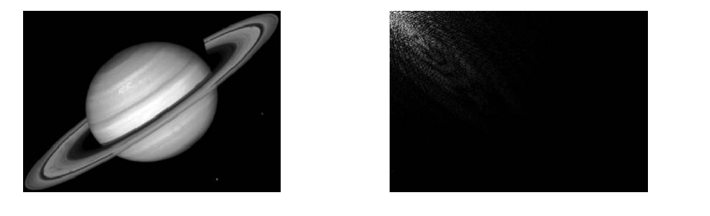
DCT Properties
Separability
Energy Compaction

Slide 7
For any K the equation is
If A consists of correlated values, then most of the DCT coefficients ( and ) produced will be zero or small numbers, and only a few are large.
A=[1 2 3 4 5 6 7 8 ]
W_{A}=[12.7279 -6.4423 0 -0.6735 0 -0.2009 0 -0.0507]
W_{A}'=[12.7279 -6.4423 0 0 0 0 0 0 ]
If condition applied is abs<1 =0

Slide 8
A=[1 2 3 4 5 6 7 8 ]
A=[1.3407 1.8217 2.7104 3.8716 5.1284 6.2896 7.1783 7.6593 ]
This is when inverse is applied to previous answer
B =[1 5 -9 -8 7 1 0 9] Un correlated data
W_{B} =[2.1213 -6.0855 7.5688 5.2571 4.2426 -11.8857 -3.9005 1.0293]
B_s = [ -9 -8 0 1 1 5 7 9] rearrangement of data
W_{B_­s} = [2.1213 -16.4520 -2.0719 -3.5681 -0.7071 1.8680 2.3890 0.3323]
DCT is always real and orthogonal We can use FFT for it’s computation
It is not real part of DFT

Slide 9
2D example
Forward Transformation

Slide 10
Energy Preservation

Slide 11
JPEG (DCT Application)

